Slide 1
Photosynthesis: You Are The Light of My Life
A Brain Target Unit on Photosynthesis
Helen Markiewicz
Explorations in Mind, Brain and Teaching
Spring 2012

Slide 2
Primary Objective
Students will apply understanding of Photosynthesis in discussions, activities and a culminating project centered around current environmental concerns regarding global warming.

Slide 3
Brain Target 1 Setting the Emotional Climate for Learning
Daily routine includes:
Collaborative teachers offer greeting as students enter room
Biology Teacher-Pascal Losambe
Learning Specialist-Helen Markiewicz
Daily objective is displayed on board
Homework is checked when seated
Specific praise used often and sincerely.
Students are allowed choice of seats, partners, and projects for this unit
Library of plant books for students to explore at will

Slide 4
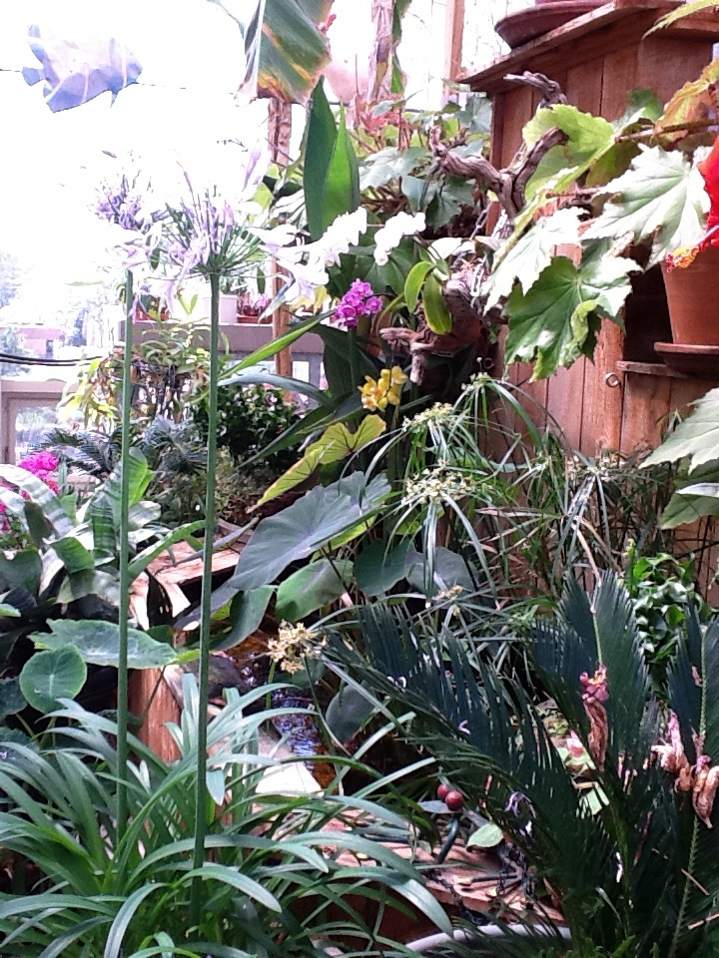
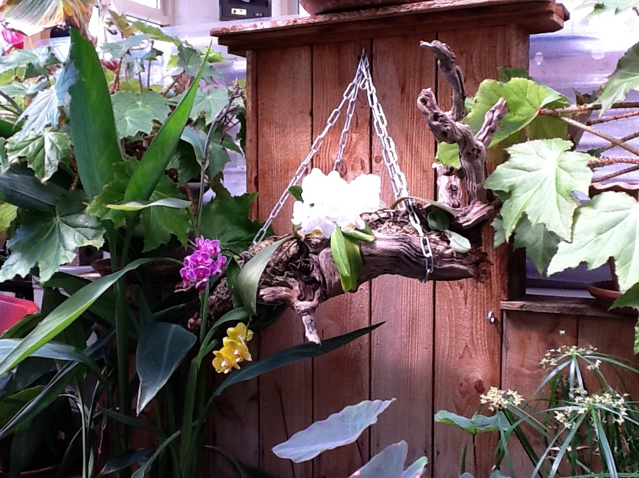
Brain Target 1 Setting the Emotional Climate for Learning
Class visit to school greenhouse down the hall
Variety of plants placed in classroom

Slide 5
Brain Target 2 Creating the Physical Learning Environment
Room was cleaned and remained orderly during unit
Blinds raised to offer natural light
Classroom seating was rearranged to encourage collaboration
Student created work placed around the room

Slide 6
Brain Target 2 Physical Environment
A variety of plants from school greenhouse were placed around the room
And the hall outside of classroom

Slide 7
Brain Target 3 Designing the Learning Experience
Concept Map was used to introduce unit
“Big Picture Activity”-Concept map was shown on smartboard and students were given individual copies. Class brainstormed for prior knowledge of photosynthesis. As new information was learned concept map was expanded and added on class website.

Slide 8
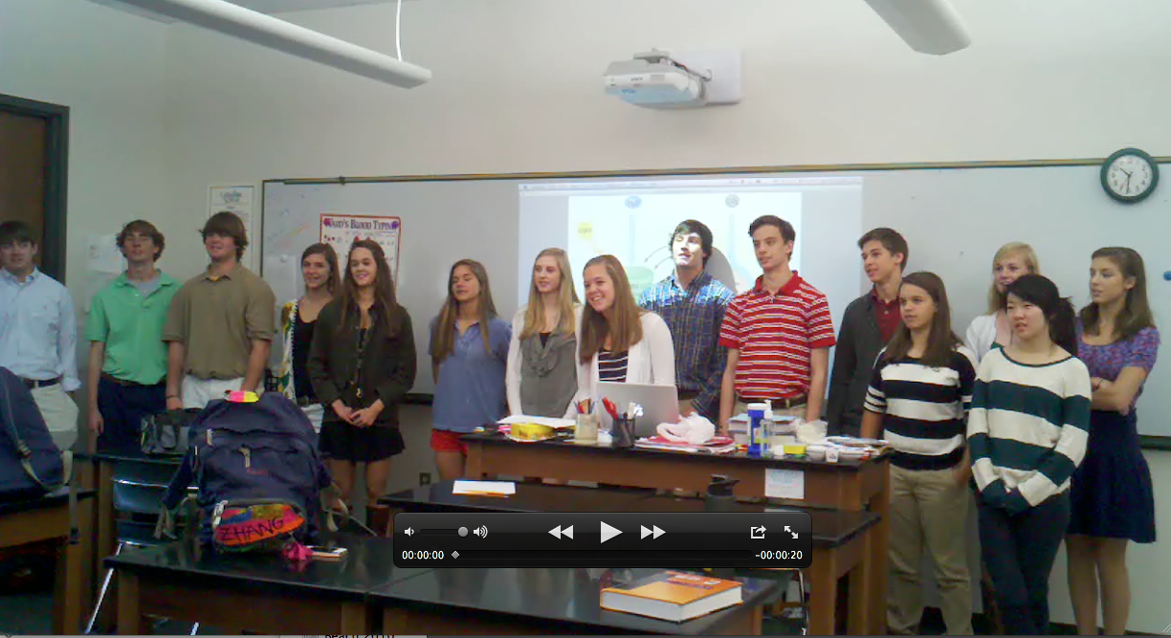
Brain Target 4 Teaching for Declarative Knowledge
Objective 1-Students will be able to demonstrate basic knowledge of overview/meaning/use of Photosynthesis
Video Lab Activity
Photosynthesis song
http://youtu.be/zP4JJ3GKR1Q

Slide 9
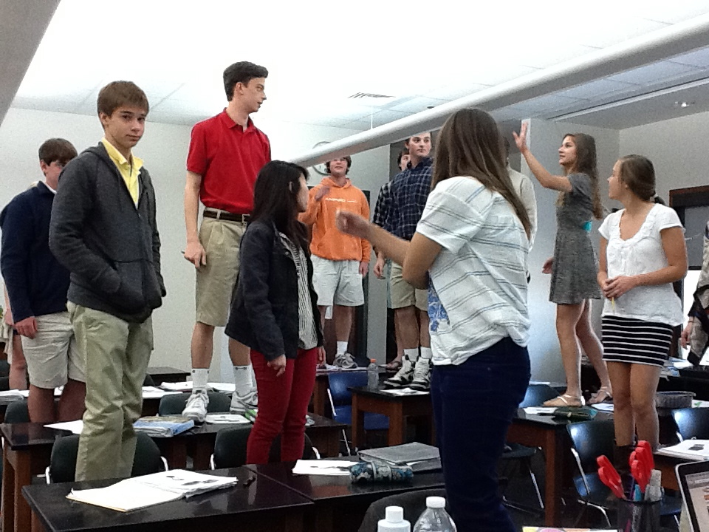
Brain Target 4 Teaching for Declarative Knowledge
Objective 2-Students will demonstrate understanding of Phase one of Photosynthesis including identifying structures and their functions
Concept map additions
Plate one of Venn Diagram
Phase One Growing --→

Slide 10
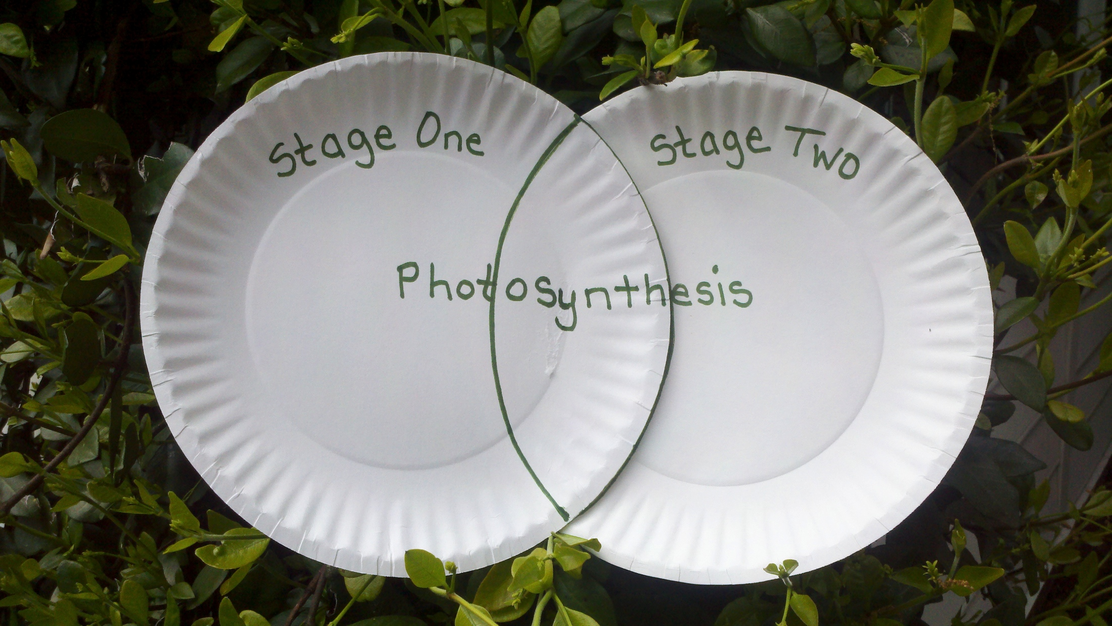
Brain Target 4 Teaching for Declarative Knowledge
Objective 3-Students will demonstrate understanding of Calvin Cycle including chemical changes and where they take place.
Computer based animation model activity
Concept Map additions
Plate 2 of Venn diagram

Slide 11
Brain Target 5 Teaching for Extension and Application of Knowledge
After being given a global warming problem students will design a creative solution demonstrating understanding of two phases of photosynthesis in a real world application

Slide 12
Brain Target 6 Evaluating Learning
Engagement in Web discussions
Ongoing outline with student notes
Self evaluation with updated concept map
Singing
Presentation Rubric
10 question self created quiz
Paper Plate Venn Diagrams

Slide 13
Ideas to Include in Future
Examples of projects/model what is expected to assist
students with thinking outside of a standard assessment box.
Plant seeds or seedlings for experiment use
Explain brain targets and reasoning of them to students prior to unit
Eucalyptus –refreshing plant scent- air fresheners to assist focus
Plan unit around school schedule with clear cut start finish dates

